Slide 1

AuditHelp
Automate and simplify the creation of compliance rules
AI Alchemists
Mahendar Prakash
Maruthi Sriram
Prabakaran P
Sai Nikhitha

Slide 2
Problem Statement
Develop a Gen AI-powered data profiling solution that can :
Extract, interpret and refine regulatory reporting instructions to identify key data validation requirements.
Automatically generate profiling rules based on allowable values and cross-relation between the elements using a Large Language Model(LLM) or Machine Learning(ML).
Suggest remediation actions for flagged transactions/observations including automated explanations for auditors.

Slide 3
Implementation Details
Automated Rule Generation: Utilized generative AI to extract and generate profiling rules from uploaded regulatory documents, enhancing the accuracy and efficiency of compliance processes. ​
Interactive Rule Refinement: Employed generative AI to refine these rules through conversational interface, allowing for dynamic adjustments based on user feedback and contextual understanding. ​

Slide 4
Implementation Details
Data Violation Detection and Remediation: Implemented generative AI to flag uploaded data that violates established rules and to suggest possible remediation actions, streamlining compliance monitoring and response. ​
Anomaly Detection: Applied unsupervised learning techniques to identify anomalies within datasets, facilitating the detection of irregular patterns that may indicate compliance issues or fraudulent activities.

Slide 5
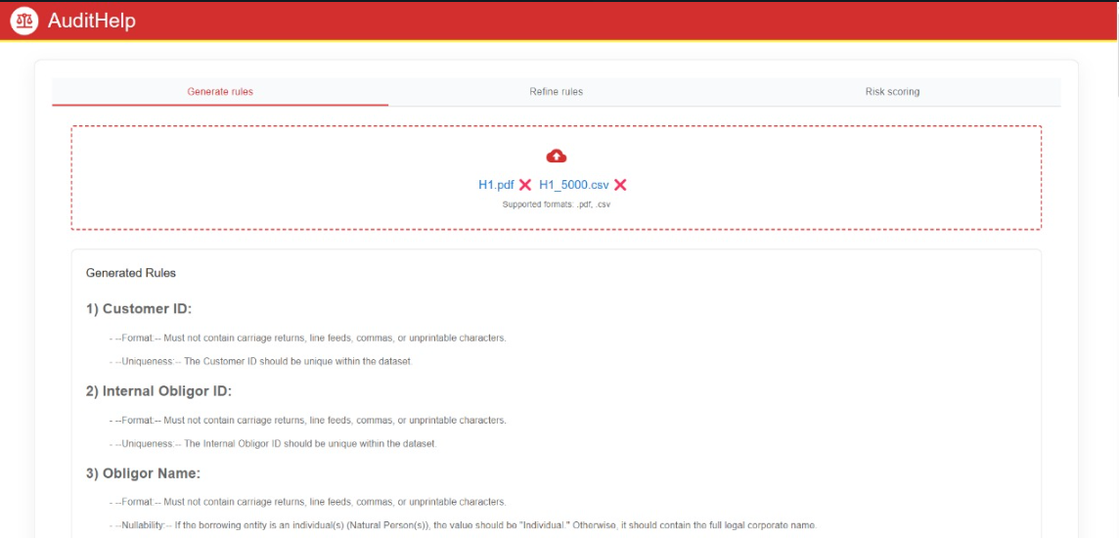
Key Functions
Upload a Regulatory document(h1.pdf) and a csv file containing sample data to feed to the model. We have used Gemini 2.0 Flash-Lite for generating the rules. Model considers column, description and allowable values from the sample regulatory document we have from FINRA(h1 schedule) in the screenshot attached.
Note: Rules are generated based on columns from regulatory doc and the sample data.

Slide 6
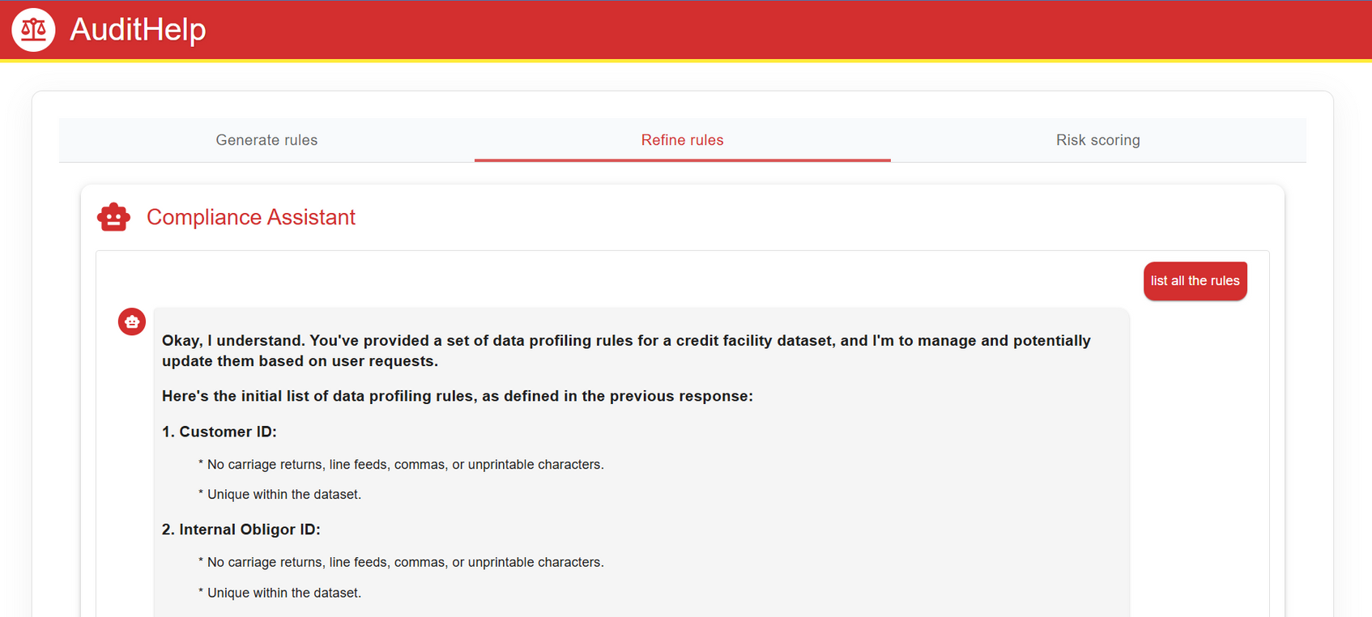
Key Functions
ChatAssistant will allow the user to refine the generated rules based on the field name. User can see the list of rules the model is using right at that moment. Once updated, the assistant will provide the user the list of all the rules along with updated ones enabling them to verify.

Slide 7
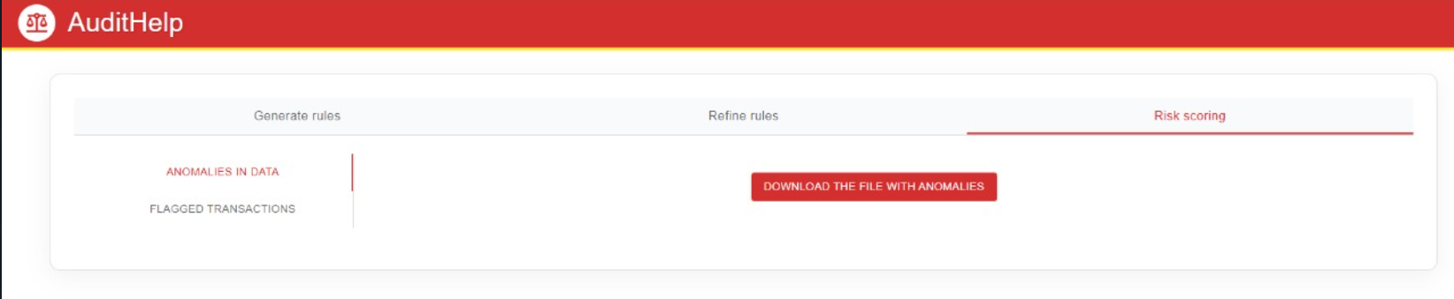
Key Functions
Using the uploaded sample dataset H1_5000.csv in the Generate Rules section, we have applied an unsupervised machine learning technique(Isolation Forest algorithm) to detect anomalies within the dataset. The model identifies and flags anomalous rows, which is then available to download for the auditor using the download button in the interface.

Slide 8
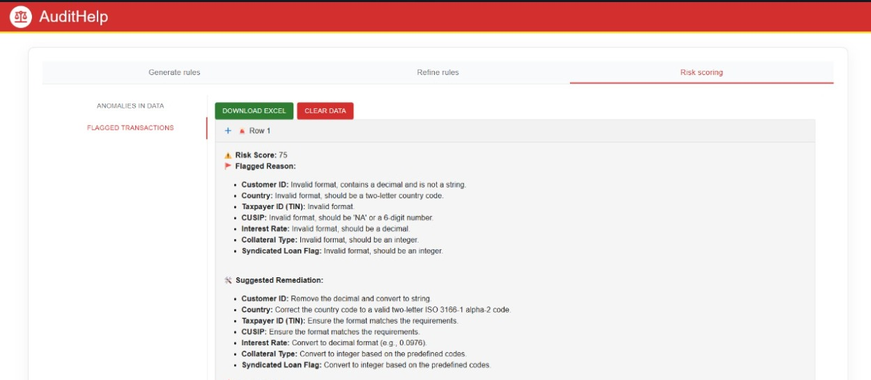
Key Functions
Using the sample dataset H1_5000.csv uploaded in the Generate Rules section, we leverage GenAI techniques to apply rules derived from the regulatory document to each record in the dataset. Any columns in a row that violate these rules are flagged, and corresponding remediation actions are suggested. These flagged violations and suggested remediations are then presented to the auditor for review.

Slide 9
Challenges
Access to comprehensive and relevant datasets would have facilitated more effective training and validation of our models, enhancing their performance and reliability.
Having official API keys would have allowed us to utilize APIs without the constraints of free-tier limitations, thereby expanding the project's capabilities and scope.
Establishing precise and stable project goals from the outset would have minimized misunderstandings and aligned development efforts, leading to a more streamlined process. ​
With higher or unlimited API usage limits, we could have continued our exploration and testing without service interruptions, allowing for more thorough development and refinement.

Slide 10
Future Scope
Real-time Anomaly Detection: Implement streaming data processing to flag anomalies in real-time.
Custom Model Fine-tuning: Allow users to train or fine-tune models on their specific datasets for better accuracy.
Support for More Data Formats: Expand support to JSON, databases, and even APIs.
Advanced Visualization: Integrate dashboards with dynamic charts and graphs for better data insights.
Real-time Risk Scoring: Leverage existing LLMs to analyze transaction history and assign risk scores to the dataset.

Slide 11
Tech stack Used
Frontend : React, Javascript
Backend : Python, FastAPI
GenAI Models Used :Gemini 2.0 Flash-Lite, nomic-embed-text

